Slide 1
IPD Behavioral Results
N=25
Updated 9/24/18

Slide 2
Review
C=Cooperate=0
D=Defect=1
SD=‘Sleep Deprived’
SR=‘Sleep Rested’
PRO=Prosocial task partner
ANTI=Antisocial task partner
‘Player’ = Participant
‘Partner’ = Computer
16 trials / run; 2 runs / condition.
ProSocial/AntiSocial Partner random order
Outcome Measures:
Overall Cooperation – rate of cooperation
First Move – Coop or Defect in first interaction?
First Defection – Round of first defection
Conditional Choice
1-back vs 2-back vs 3-back
Choice Deliberation-Time

Slide 3
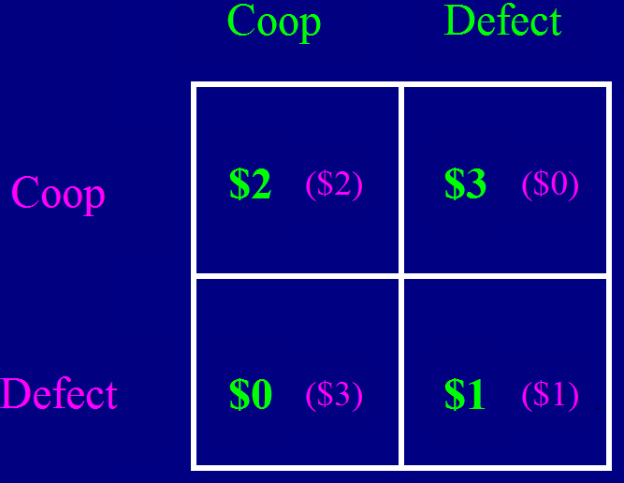
Total Earned: $$
Trial: (x16)
Choice
+
Outcome
+
0sec
6
14
22

Slide 4
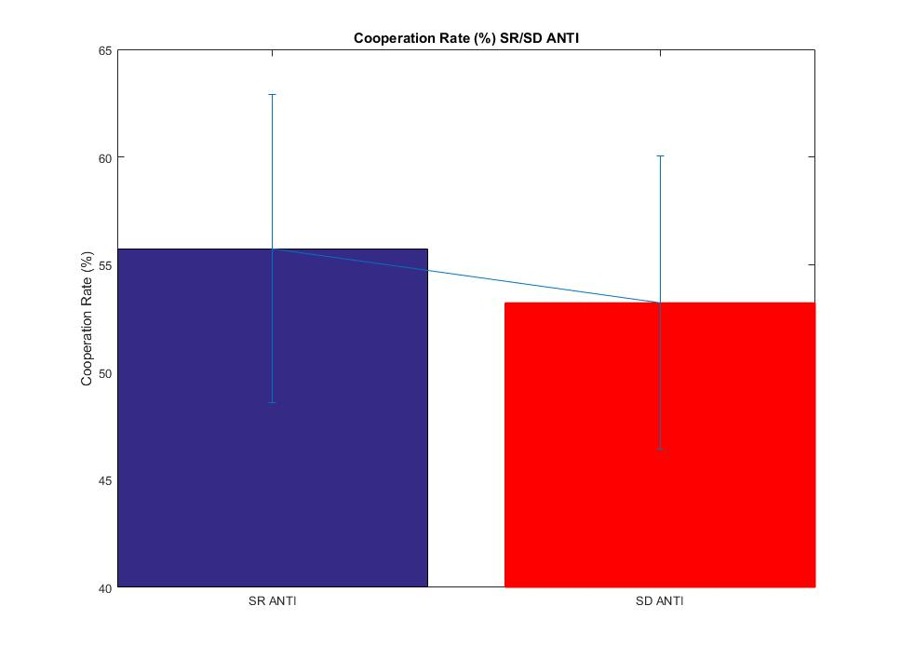
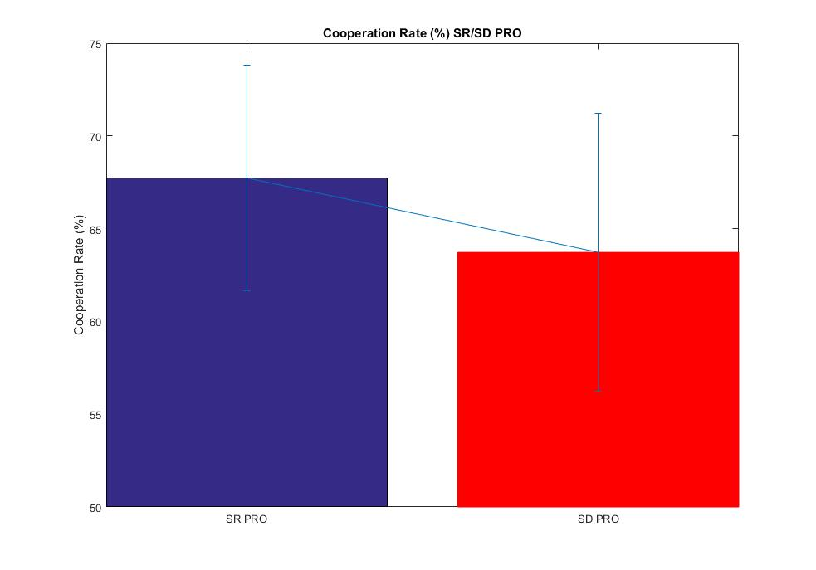
Cooperation Rate
Fixed for missed Responses
P= 0.43
P= 0.71
Excluding Cooperaters-only does not change significance
PRO, p=0.43; ANTI, p=0.71

Slide 5
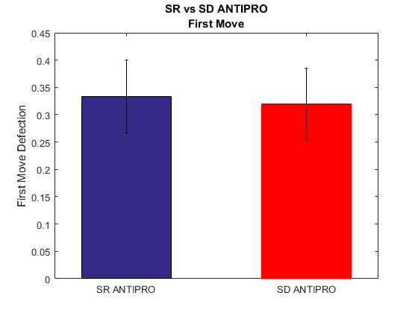
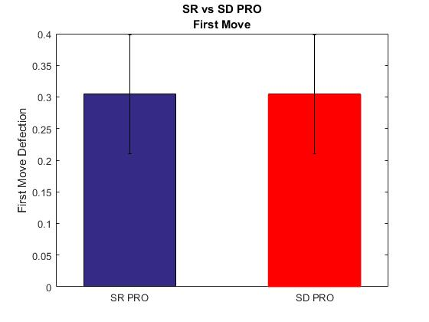
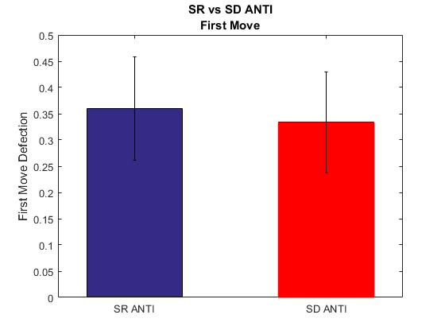
First Round Choice
Fixed for missed Responses
P=.81
SR and SD identical behavior at beginning of game. Also evident in choice-RTs.
P=.99
P=.72

Slide 6
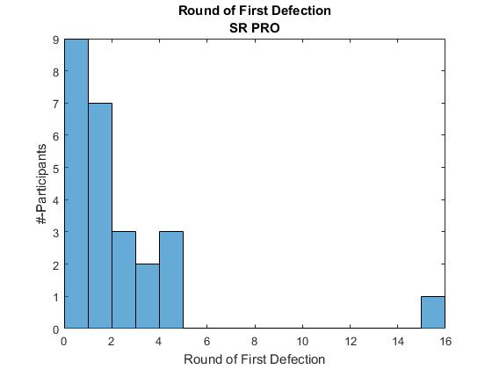
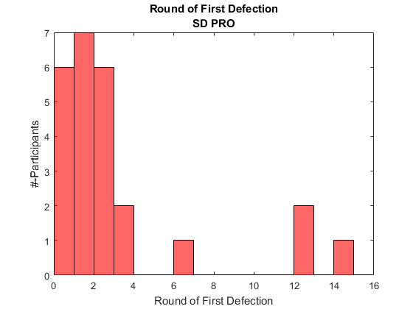
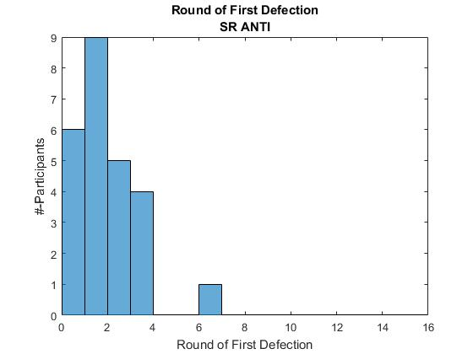
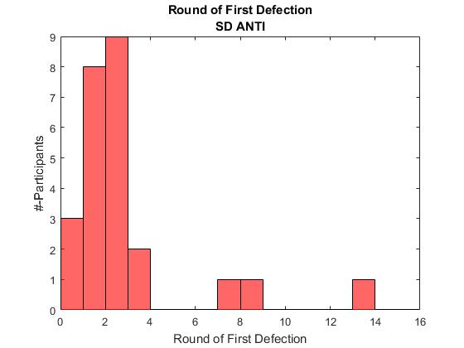
When is first non-cooperative choice? Round of First Defection
*
Fixed for missed Responses
*
*Always Cooperated
(More constant-cooperators in SR vs SD)
*
*

Slide 7
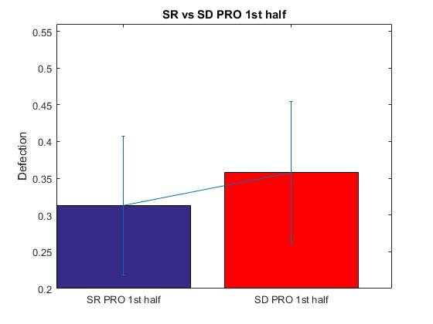
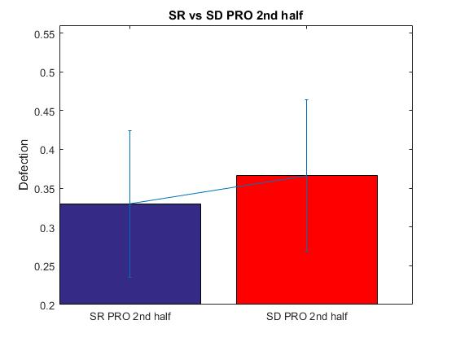
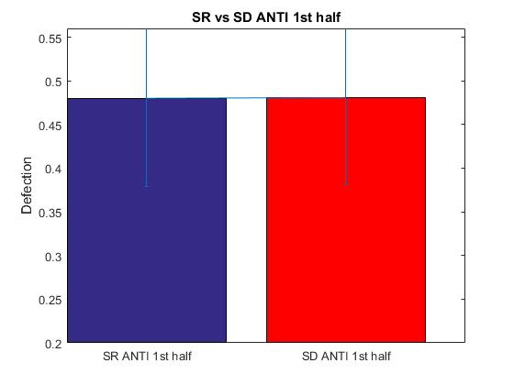
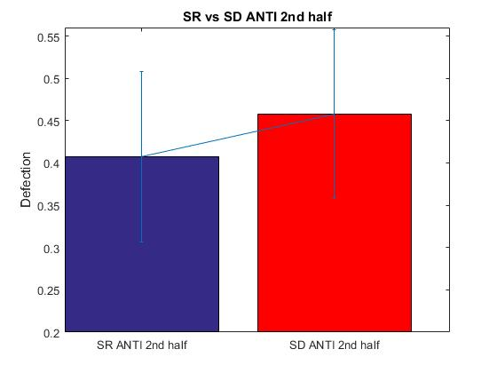
1st half / 2nd half Choice Comparisons
Fixed for missed Responses
P=0.14
P=0.22
P=0.88
P=0.45

Slide 8
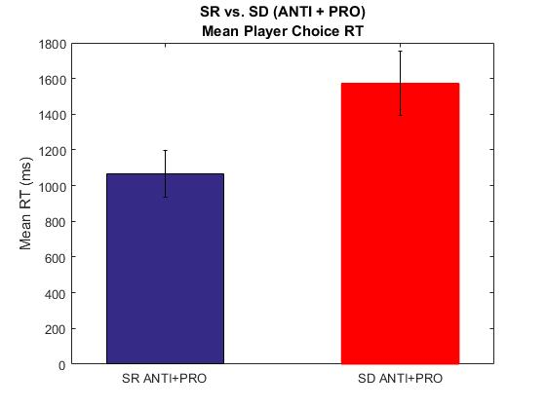
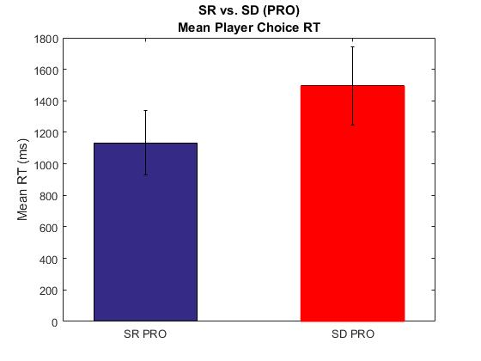
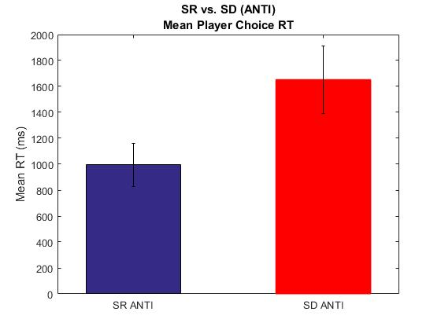
RT analysis Overall Choice-RT
Fixed for missed Responses
P<0.0000001
P = 0.0000004
P<0.0000001

Slide 9
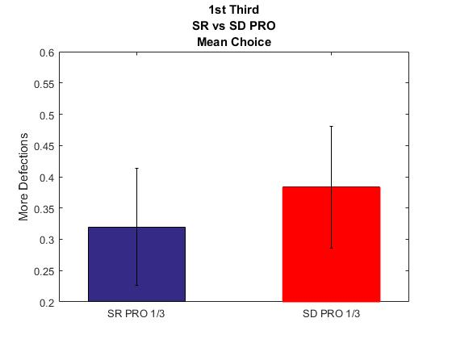
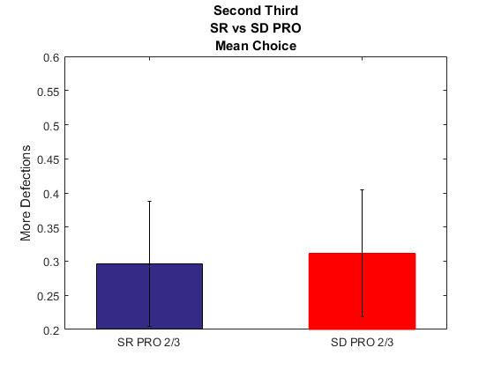
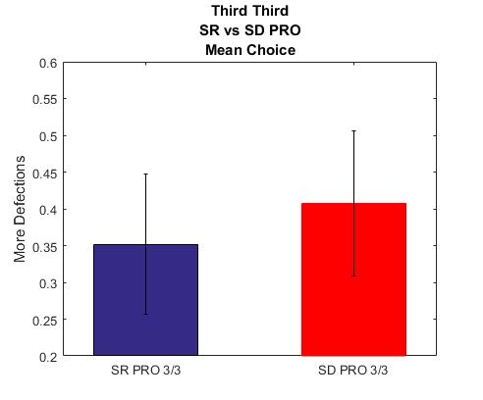
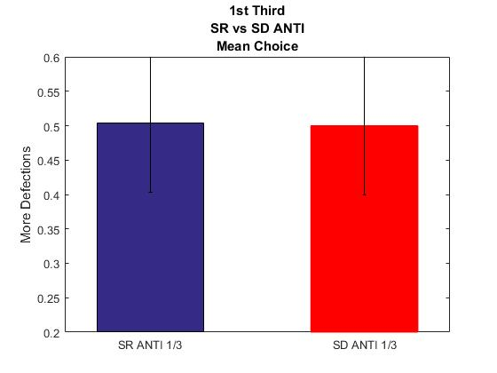
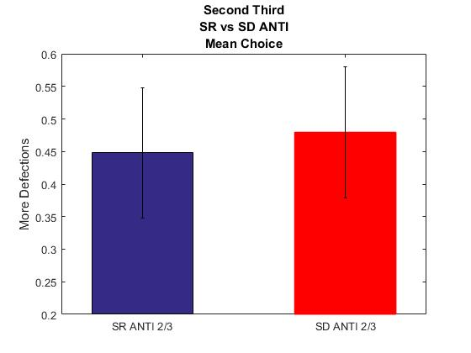
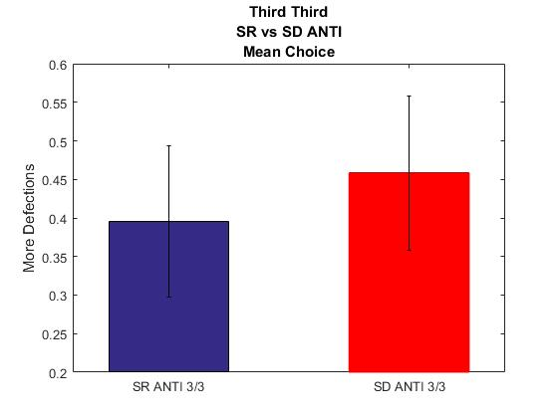
Choice Comparisons 3rds –Rounds 2-6; 7-11; 12-16
Fixed for missed Responses
P = 0.07
P = 0.61
P = 0.33
P = 0.88
P = 0.53
P = 0.28

Slide 10
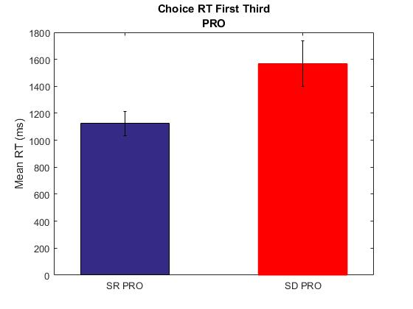
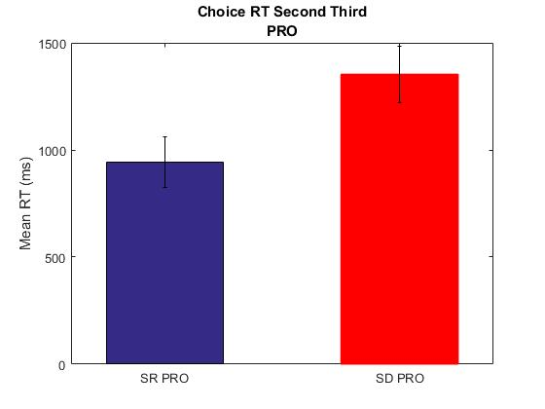
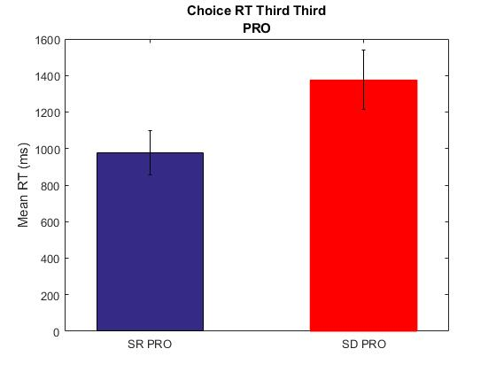
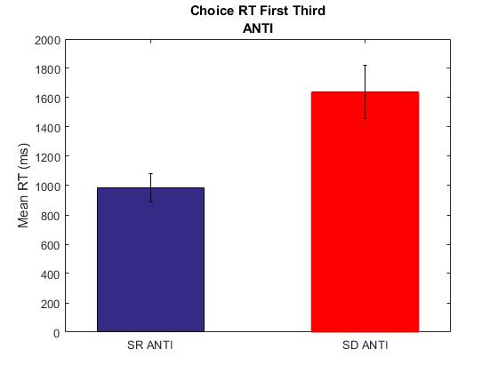
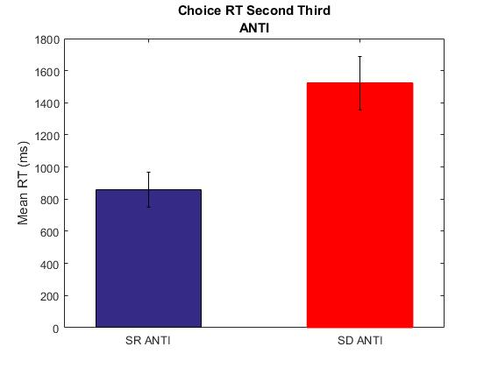

Choice RT Comparisons 1/3rds –Rounds 2-6; 7-11; 12-16
Fixed for missed Responses
P = 0.006
P = 0.01
P = 0.037
P = 0.0029
P = 0.0019
P = 0.006
Notes:
Correlations between RT and Choice type by 1/3 of task
SR:
[r,p]=corrcoef(SubMeans_RT_First_third_SR_PRO, SubMeans_Choice_First_third_SR_PRO)%r=-0,02; p=.90
[r,p]=corrcoef(SubMeans_RT_Second_third_SR_PRO, SubMeans_Choice_Second_third_SR_PRO)%r=-0,06; p=.75
[r,p]=corrcoef(SubMeans_RT_Third_third_SR_PRO, SubMeans_Choice_Third_third_SR_PRO)%r=-0,17; p=.39
[r,p]=corrcoef(SubMeans_RT_First_third_SR_ANTI, SubMeans_Choice_First_third_SR_ANTI)%r=.12; p=.55
[r,p]=corrcoef(SubMeans_RT_Second_third_SR_ANTI, SubMeans_Choice_Second_third_SR_ANTI)%r=.02; p=.89
[r,p]=corrcoef(SubMeans_RT_Third_third_SR_ANTI, SubMeans_Choice_Third_third_SR_ANTI)%r=-.05; p=.78
SD:
[r,p]=corrcoef(SubMeans_RT_First_third_SD_PRO, SubMeans_Choice_First_third_SD_PRO)%r=0.26; p=.19
[r,p]=corrcoef(SubMeans_RT_Second_third_SD_PRO, SubMeans_Choice_Second_third_SD_PRO)%r=0.07; p=.72
[r,p]=corrcoef(SubMeans_RT_Third_third_SD_PRO, SubMeans_Choice_Third_third_SD_PRO, 'rows','complete')%r=0.17; p=.43
[r,p]=corrcoef(SubMeans_RT_First_third_SD_ANTI, SubMeans_Choice_First_third_SD_ANTI)%r=0.07; p=.71
[r,p]=corrcoef(SubMeans_RT_Second_third_SD_ANTI, SubMeans_Choice_Second_third_SD_ANTI)%r=0.39; p=.0498
[r,p]=corrcoef(SubMeans_RT_Third_third_SD_ANTI, SubMeans_Choice_Third_third_SD_ANTI)%r=0.38; p=.06

Slide 11
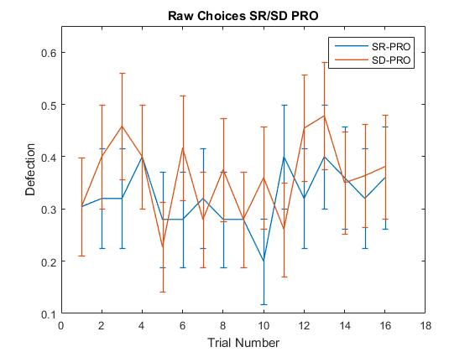
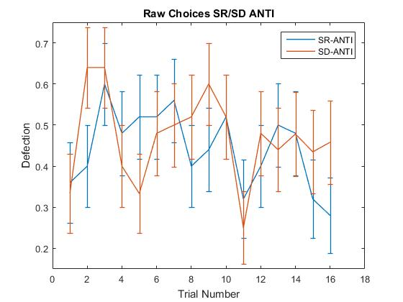
Group Raw Choices
Fixed for missed Responses
*0.04
0.08
0.05
NOTE: Removing participants (n=3, PRO; n=2, ANTI) who purely cooperated does not change these p-values

Slide 12
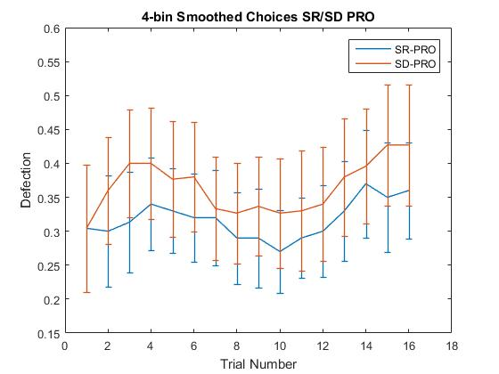
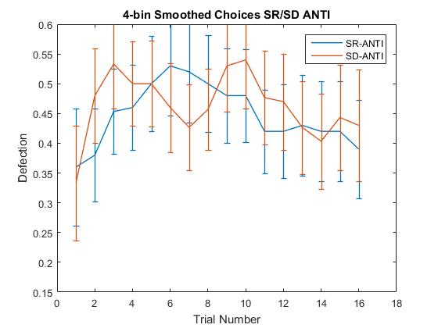
Group Smoothed Choices
Fixed for missed Responses
4-round moving mean smoothing. No averaging for rounds 1-3.
All p > .12
All p > .25
NOTE: Removing participants (n=3, PRO; n=2, ANTI) who purely cooperated does not change these p-values

Slide 13
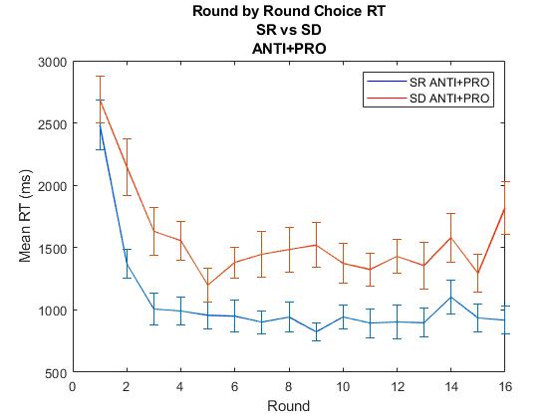
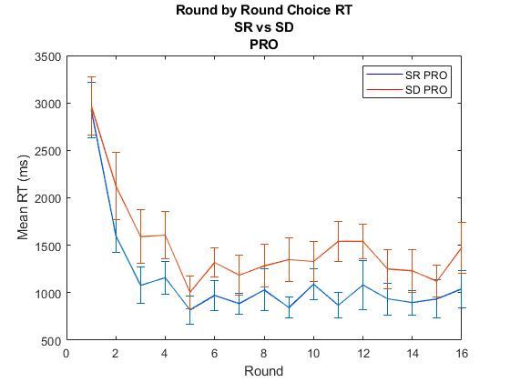
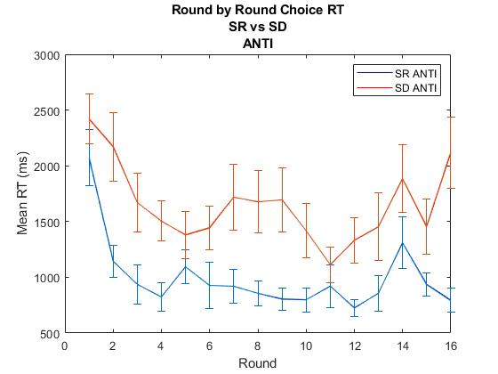
Round by round Choice RT
Fixed for missed Responses

Slide 14
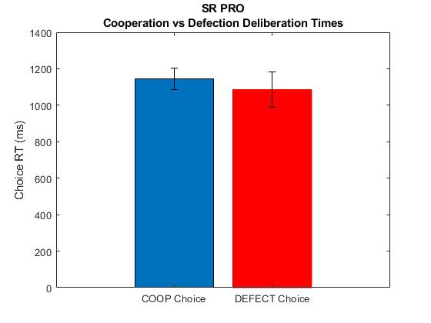
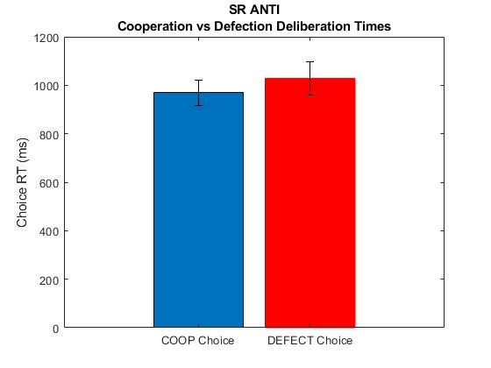
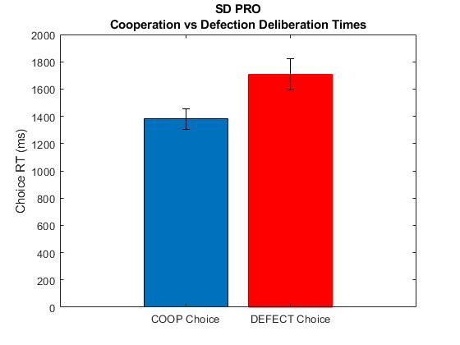
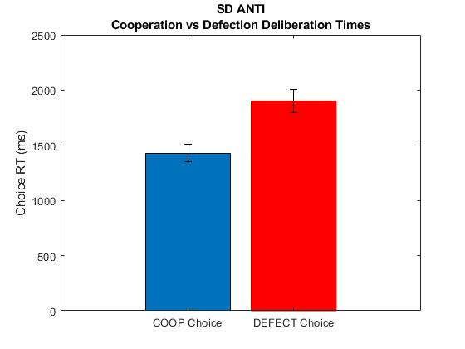
Reaction Time and Choice-Type
Fixed for missed Responses
Sleep Deprivation has significantly different RTs for cooperate vs defect choices. No difference for Sleep Rested.
P>0.59
P>0.47
P=0.014
P=0.0003
P>0.65
P>0.22

Slide 15
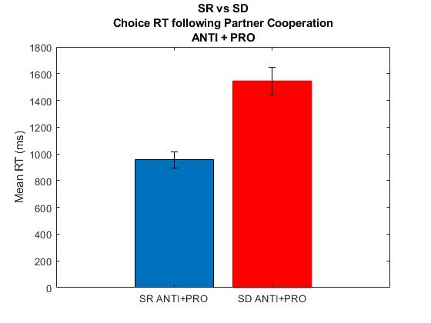
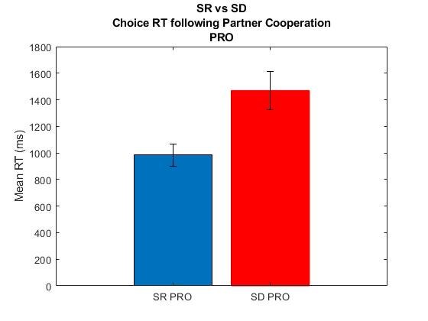
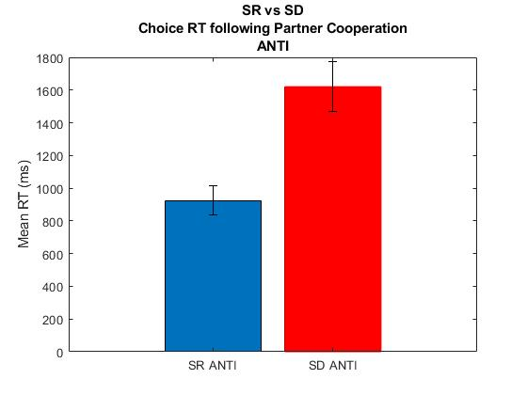
RT analysis Conditional Choice-RT 1-back following Partner Coop. Does RT differ depending on prior partner behavior?
Fixed for missed Responses
P=0.00004
P = .0007
P = 0.0023

Slide 16
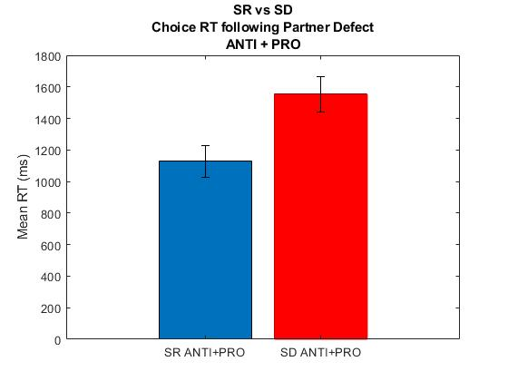
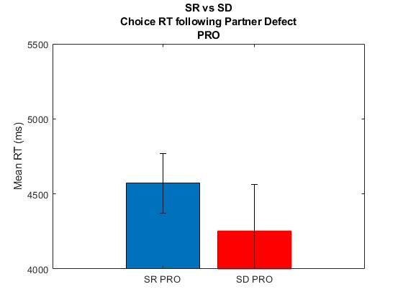
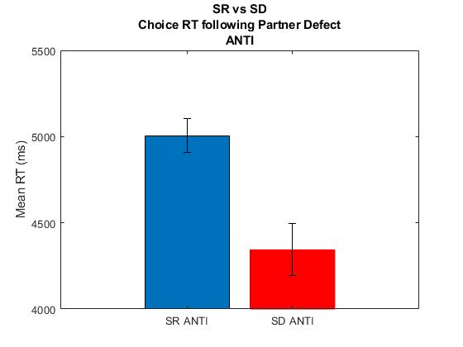
RT analysis Conditional Choice-RT 1-back following Partner Defect NOTE: These RTs are averaged regardless of whether Player Cooperated or Defected. See next slide for that.
Fixed for missed Responses
P=0.01
P=0.92
P=0.0013

Slide 17
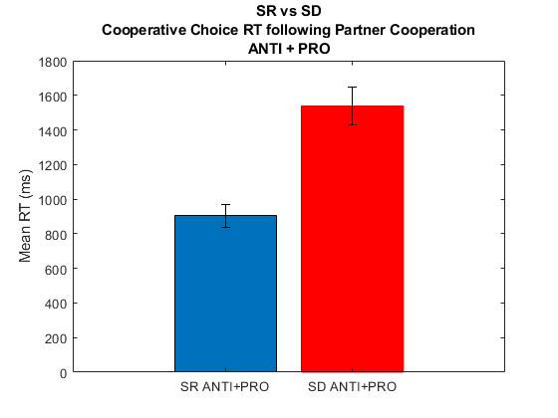
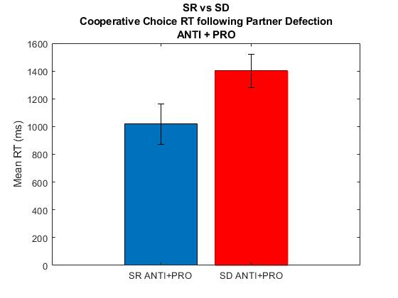

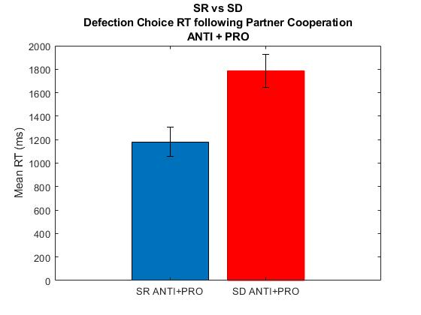
RT analysis Conditional Choice-RT 1-back Player Coop/Defect RT following Partner Coop/Defect
Fixed for missed Responses
P=0.01
P=0.000009
P=0.02
P=0.00019

Slide 18
Conditional Choice Analyses
How is Player Choice affected by prior Partner Choices?
What is the temporal window of previous Partner choices used for subsequent Player choices?
1-back vs 2-back vs 3-back
Is choice deliberation-time affected by prior Partner choice?

Slide 19
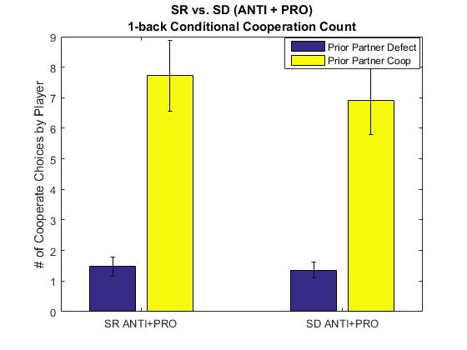
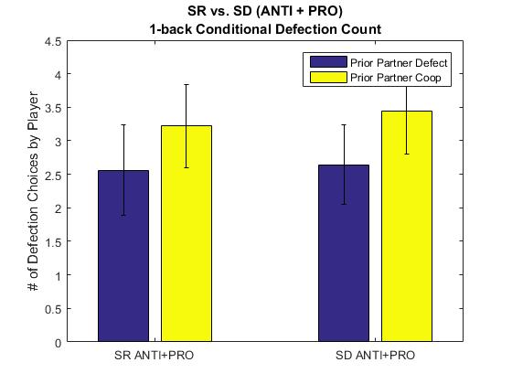
Conditional Choices (1-back) raw
Fixed for missed Responses
Notation: C,C reads as Player Cooperation given prior Partner Cooperation
D,C – Player Defection given prior Partner Cooperation
P=0.19
P=0.59
P=0.86
P=0.64

Slide 20

Conditional Choices (1-back) normalized
Fixed for missed Responses
P=0.18
P=0.24
P=0.20
P=0.30

Slide 21


Conditional Choices (1-back) normalized PRO
Fixed for missed Responses
P=0.22
P=0.15
P=0.40
P=0.29

Slide 22

Conditional Choices (2-back)
Fixed for missed Responses
C,CC - Player Cooperation given 100% partner coop
C,CD (or DC) – Player cooperation given 50% partner cooperation
C, DD—Player cooperation given 0% partner cooperation
Mean of ANTI and PRO
P=0.089
P=0.21
P=0.61

Slide 23



Conditional Choices (2-back) Histograms - SR
Fixed for missed Responses

Slide 24



Conditional Choices (2-back) Histograms - SD
Fixed for missed Responses

Slide 25

Fixed for missed Responses
P=0.08
P=0.56
P=0.54

Slide 26



Conditional Choices (2-back) Histograms – SR PRO
Fixed for missed Responses

Slide 27



Conditional Choices (2-back) Histograms – SD PRO
Fixed for missed Responses

Slide 28

Fixed for missed Responses
P=0.36
*P=0.038
P=0.84

Slide 29



Conditional Choices (2-back) Histograms – SR ANTI
Fixed for missed Responses

Slide 30



Conditional Choices (2-back) Histograms – SD ANTI
Fixed for missed Responses

Slide 31

Comparing 1-back to 2-back #-Player Cooperations following Partner Cooperation PRO+ANTI
R = 0.94

Slide 32

Comparing 1-back to 2-back #-Player Cooperations following Partner Cooperation PRO
R = 0.92

Slide 33

Comparing 1-back to 2-back #-Player Cooperations following Partner Cooperation ANTI
R = 0.97

Slide 34

Comparing 1-back to 3-back #-Player Cooperations following Partner Cooperation PRO+ANTI
R = 0.87

Slide 35

Comparing 1-back to 3-back #-Player Cooperations following Partner Cooperation PRO
R = 0.84

Slide 36

Comparing 1-back to 3-back #-Player Cooperations following Partner Cooperation ANTI
R = 0.92

Slide 37

Comparing N-Back Conditional Choice (not normalized) Given 100% Prior Partner Cooperation SD vs SR P-values

Slide 38


Defection following Partner Coop Correlations to IL6 raw and %-change
R=0.17
P=0.50
Outlier removed
R=0.15
P=0.54
Outlier removed
R=0.04
P=0.87
R=0.25
P=0.29

Slide 39

3-back Conditional Choice ANTI+PRO Raw Cooperation Count
P=0.082
P=0.24
P=0.37

Slide 40



3-back Conditional Choice ANTI+PRO Raw Cooperation Count – Histograms SR

Slide 41



3-back Conditional Choice ANTI+PRO Raw Cooperation Count – Histograms SR

Slide 42

3-back Conditional Choice PRO Raw Cooperation Count
P=0.07
P=0.90
P=0.33

Slide 43



3-back Conditional Choice PRO Raw Cooperation Count – Histograms SR

Slide 44



3-back Conditional Choice PRO Raw Cooperation Count – Histograms SD

Slide 45

3-back Conditional Choice ANTI Raw Cooperation Count
P=0.33
P=0.13
P=0.54

Slide 46



3-back Conditional Choice ANTI Raw Cooperation Count – Histograms SR

Slide 47



3-back Conditional Choice ANTI Raw Cooperation Count – Histograms SD

